Slide 1
House-Price Prediction
Bowen Wang, Jiaming Chu, Ryder Swanson, Yanlei Song

Slide 2
Motivation
Predicting housing prices is a complex and important problem in real estate, benefiting stakeholders such as buyers, sellers, and agents. By using machine learning techniques, our project aims to provide an accurate model for predicting housing prices based on available data.

Slide 3
Data Preparation
Our dataset was sourced from publicly available resources provided by the State of Washington. We utilized a comprehensive dataset containing information on all parcels of land within the state, which we subsequently filtered to focus specifically on Whitman County. We then leveraged this information to access corresponding county assessor website details, thereby obtaining relevant data points such as number of rooms and square footage.
Data Cleaning The data cleaning process for this dataset involved a straightforward approach. Initially, we eliminated parcels lacking a valid address or without any structures. Subsequently, we removed parcels with incomplete data, including those missing square footage or age information. This refining process yielded a robust dataset consisting of approximately 10,000 properties with sufficient data.

Slide 4
Methodology
Gradient Boosting Machine (GBM): A tree-based boosting method optimized for high performance.
XGBoost: A highly efficient gradient boosting library.
Random Forest: A bagging-based ensemble method with interpretable results.

Slide 5
Results and Analysis
The comparative performance of the three models—Gradient Boosting Machine (GBM), XGBoost, and Random Forest—revealed that all three yielded very similar predictive capabilities. This observation holds not only for single evaluations but also for results averaged over 100 iterations. The summarized metrics from the 100 iterations are as follows:

Slide 6
Metric | Model | Range (Min, Max) | Average | Median
RMSE | GBM | (85,639.7, 93,816.46) | 89,050.01 | 88,808.52
 | XGBoost | (85,116.68, 93,318.99) | 88,677.78 | 88,408.12
 | Random Forest | (85,526.78, 94,166.42) | 89,390.64 | 89,231.21
R² | GBM | (0.499, 0.585) | 0.55 | 0.55
 | XGBoost | (0.505, 0.585) | 0.55 | 0.56
 | Random Forest | (0.492, 0.582) | 0.55 | 0.55
MAE | GBM | (65,915.59, 71,348.66) | 68,133.65 | 67,966.34
 | XGBoost | (65,196.45, 70,292.42) | 67,380.51 | 67,337.89
 | Random Forest | (65,055.38, 70,893.94) | 67,747.22 | 67,506.29

Slide 7
Efforts to Optimize Performance
Feature Engineering:
Created derived features like rooms_per_area and age_condition_interaction to capture complex relationships.
Hyperparameter Tuning:
Fine-tuned learning rate, tree depth, and number of iterations for all models.
Example: GBM reached optimal RMSE around 2,500-3,000 iterations.
Cross-Validation:
Used 5-fold cross-validation to ensure robust performance across different data splits.
Outlier Removal:
Filtered extreme values in Total_Value and Total_Area (3rd–97th percentiles).
These efforts reduced noise, balanced bias-variance trade-offs, and improved overall model stability.

Slide 8
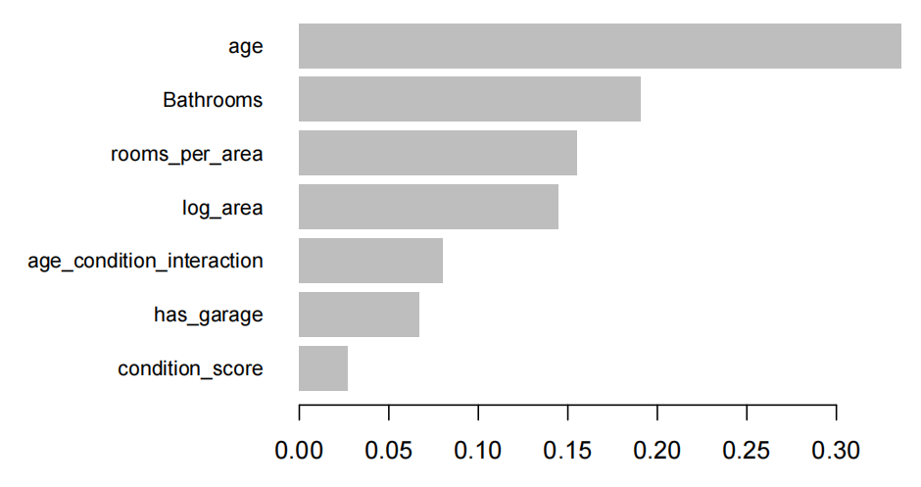
Feature Importance Analysis
Top Features:
Age: Most significant predictor of house price.
Bathrooms: Influences housing value directly.
Rooms per Area: Indicates efficient use of space.

Slide 9
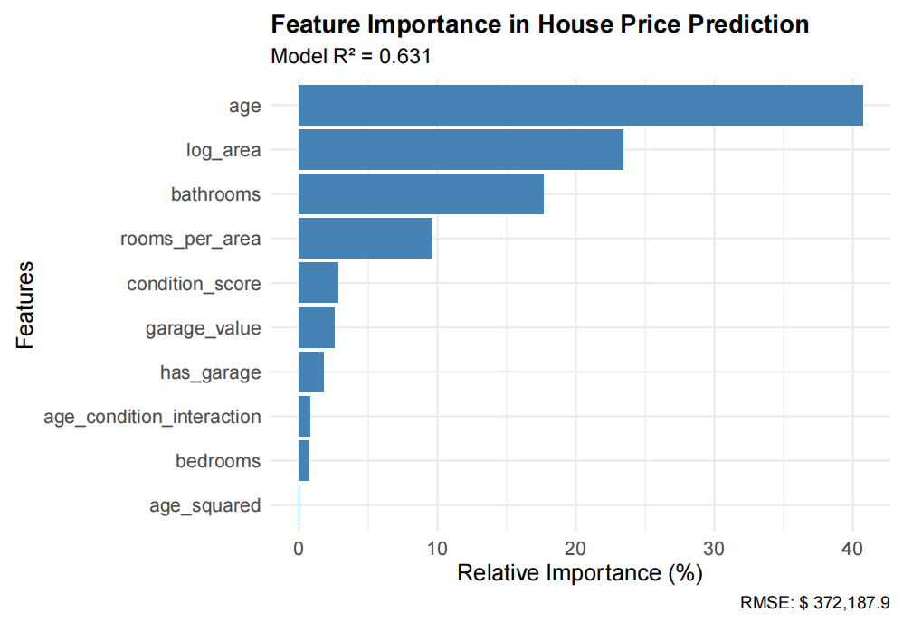
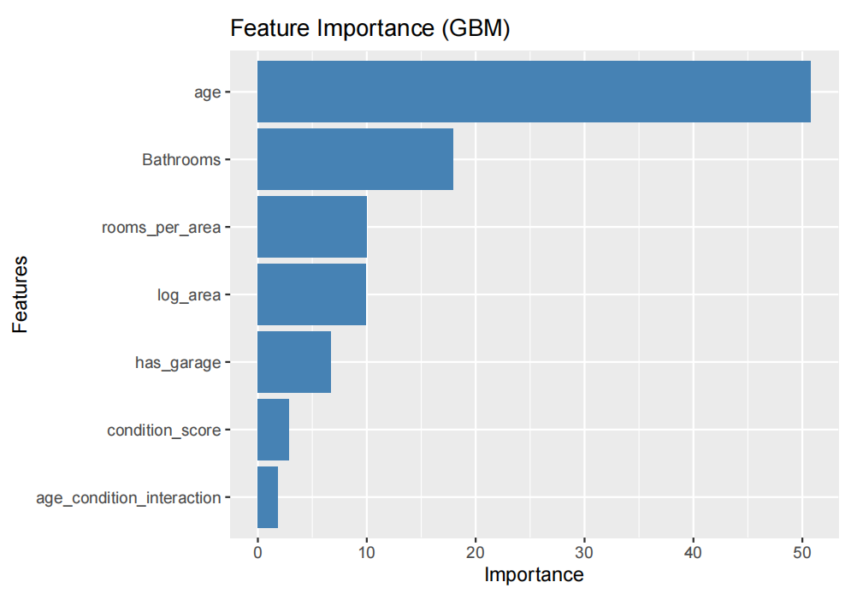
Impact of Feature Choices
Tested Features with Limited Impact:
age_squared: Added as a non-linear term, but it increased noise and did not improve predictive power.
bedrooms: Initial results showed weak correlation with price; removed to reduce feature noise.
Impact on Performance:
Removing low-impact features reduced overfitting and improved generalization.
Feature importance chart reflecting refined key predictors (e.g., Age, Bathrooms).
Residual plots showing decreased spread after removing noisy features.

Slide 10
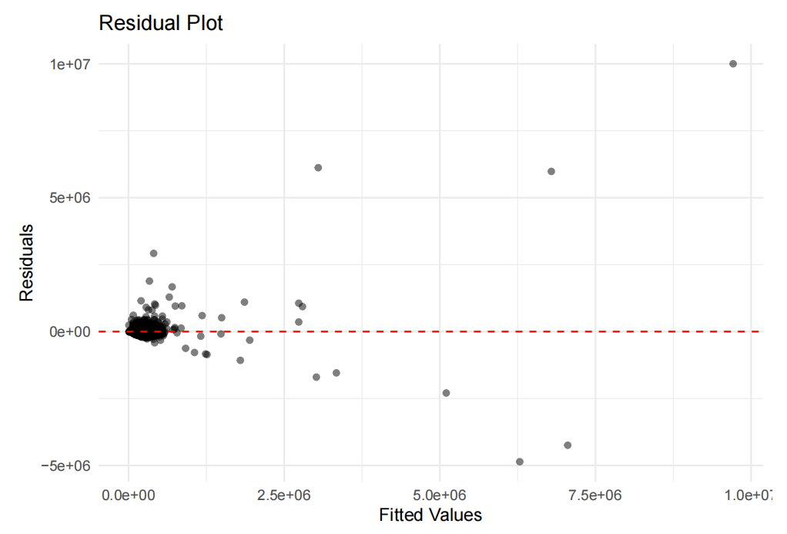
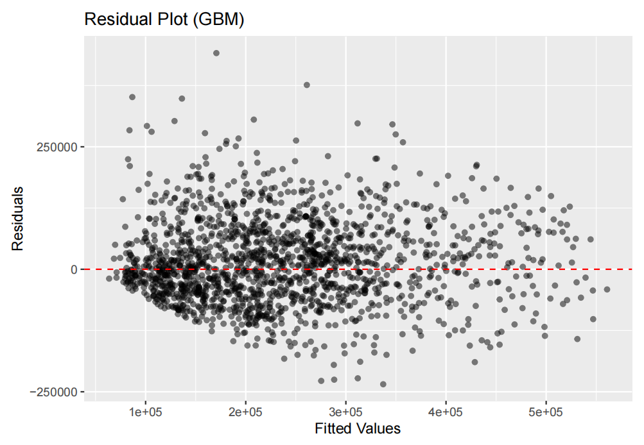
Impact of Feature Choices
Tested Features with Limited Impact:
age_squared: Added as a non-linear term, but it increased noise and did not improve predictive power.
bedrooms: Initial results showed weak correlation with price; removed to reduce feature noise.
Impact on Performance:
Removing low-impact features reduced overfitting and improved generalization.
Feature importance chart reflecting refined key predictors (e.g., Age, Bathrooms).
Residual plots showing decreased spread after removing noisy features.

Slide 11
Thank you for watching!

